Slide 1
Modified Gravity
3. Where
Eric Linder
UC Berkeley
Essential Cosmology for the Next Generation 7 14 December 2017

Slide 2
This Course
Why and What?
Ways to modify gravity and ways not to. The many failures and why. What makes a consistent physical theory.
2. How?
Ways to model independently modify gravity.
Update: arXiv:1712.04398 claims self-tuning theories can survive (not clear if cosmological)
3. Where?
Where are we now? Where do we go next?

Slide 3

Connecting Theory to Observation
Practical use of EFT/property functions, i.e. fitting time dependence, has not succeeded so far – and doesn’t look promising.
1 parameter f(R) gravity
Today
How can we connect theory to observations in practice to learn about modified gravity?

Slide 4
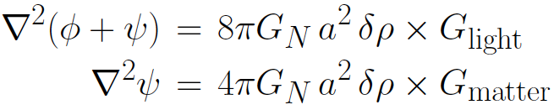
Observations First
Instead, put the observations in forefront.
Modified Poisson equations Bertschinger & Zukin 2008, Zhao+ 2009; Song+ 2010; Daniel+ 2010, Bertschinger 2011...
weak lensing
growth
This is robust. The question is only how complicated is the time and space dependence of G_{m}(k,a), G_{l}(k,a).

Slide 5
Observations First
Gravitational slip
In Horndeski gravity
Linder, Sengor, Watson 1512.06180 following Bellini & Sawicki 1404.3713

Slide 6
Observations First
Here we focus on the cosmic growth of structure and show that very simple parametrization of G_{m}(k,a) works very well.
That is, it reproduces the observations as well as the exact theory does (within measurement uncertainty).
But first, let’s examine where we were at the beginning of 2017, and some cautionary tales.

Slide 7
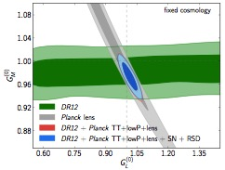
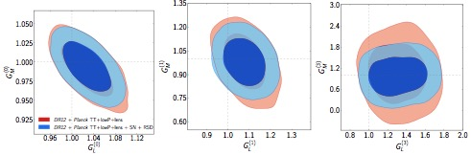
Cosmic Growth + Light Deflection
Modified gravity affects both the growth of structure and the deflection of light (lensing). Look at the effective gravitational strength for each: G_{M}, G_{L}.
Mueller+ arXiv:1612.00812
a⁰
a¹
a³

Slide 8
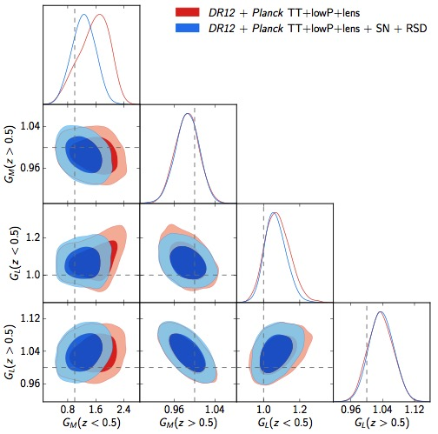
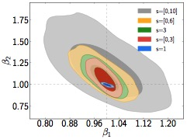
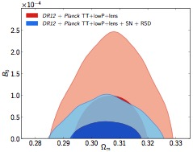
Strengths of Gravity
The assumed model or time variation has a major impact on observational constraints.
a^{s}

Slide 9
Expansion History vs Growth History
Since the growth rate is very flat with redshift, one can instead compare growth directly with expansion.
This has some features that show growth effects beyond expansion.
Dark energy models
Modified gravity models
H/H₀
H/H₀
Linder 1610.05321
fσ₈
fσ₈

Slide 10
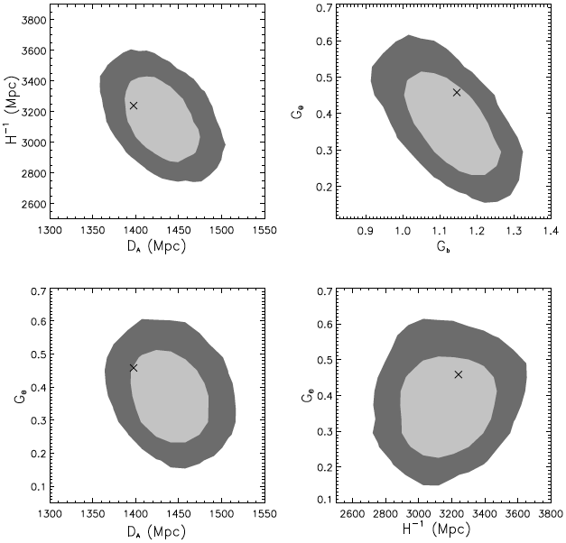
Cosmic Growth vs Expansion
Growth vs expansion can be tested in a model independent way.
Beyond linear clustering must treat modGR consistently (perturbation theory).
expansion
growth (v)
distance
growth (δ)
BOSS DR11
growth
growth
distance
expansion
Song+ 1507.01592

Slide 11
Cosmic Growth Rate
For cosmic growth we focus on G_{matter}. Can we avoid parametrizing it (since it can be complicated)?
Look at the growth rate f.
Ignoring the small squared term, this has solution

Slide 12
Cosmic Growth Factor
Consider the integral form of the growth rate eq.
When one component dominates, the square bracket is constant and we have a term
This is very interesting because the growth factor deviation

Slide 13
Parametrization without Parametrization
For gravitational deviations during matter domination
After the deviation dG_{m}, df fades rapidly, as (a⁴H)⁻¹~a^{-5/2}-a⁻⁴. So growth deviations only depend on the “area” of the modification dG_{m}, not the whole dG_{m}(a). No need to parametrize dG_{m}(a)!
Denissenya & Linder 1703.00917

Slide 14
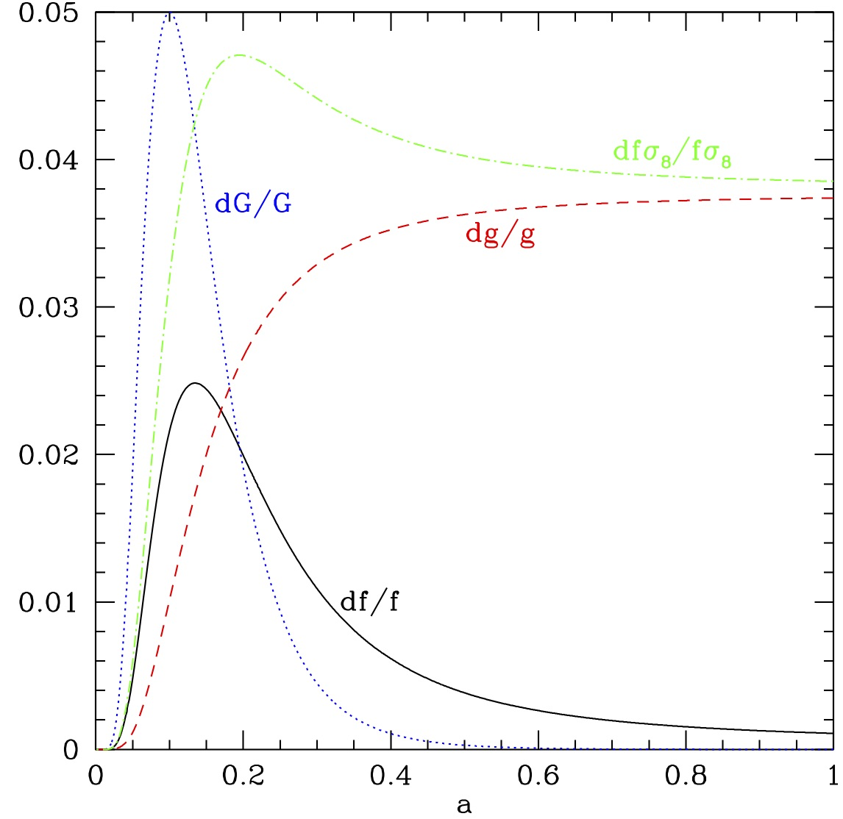
Signatures in Cosmic Growth
df is a lagged, skewed version of dG_{m}, dg approaches a constant offset, dfσ₈ is a convolution of these two.

Slide 15
Accurate Parametrization
All that is important is the area under dG_{m}, not G_{m}(a). This one parameter model is accurate to ~0.3% in the observables g, fσ₈.

Slide 16
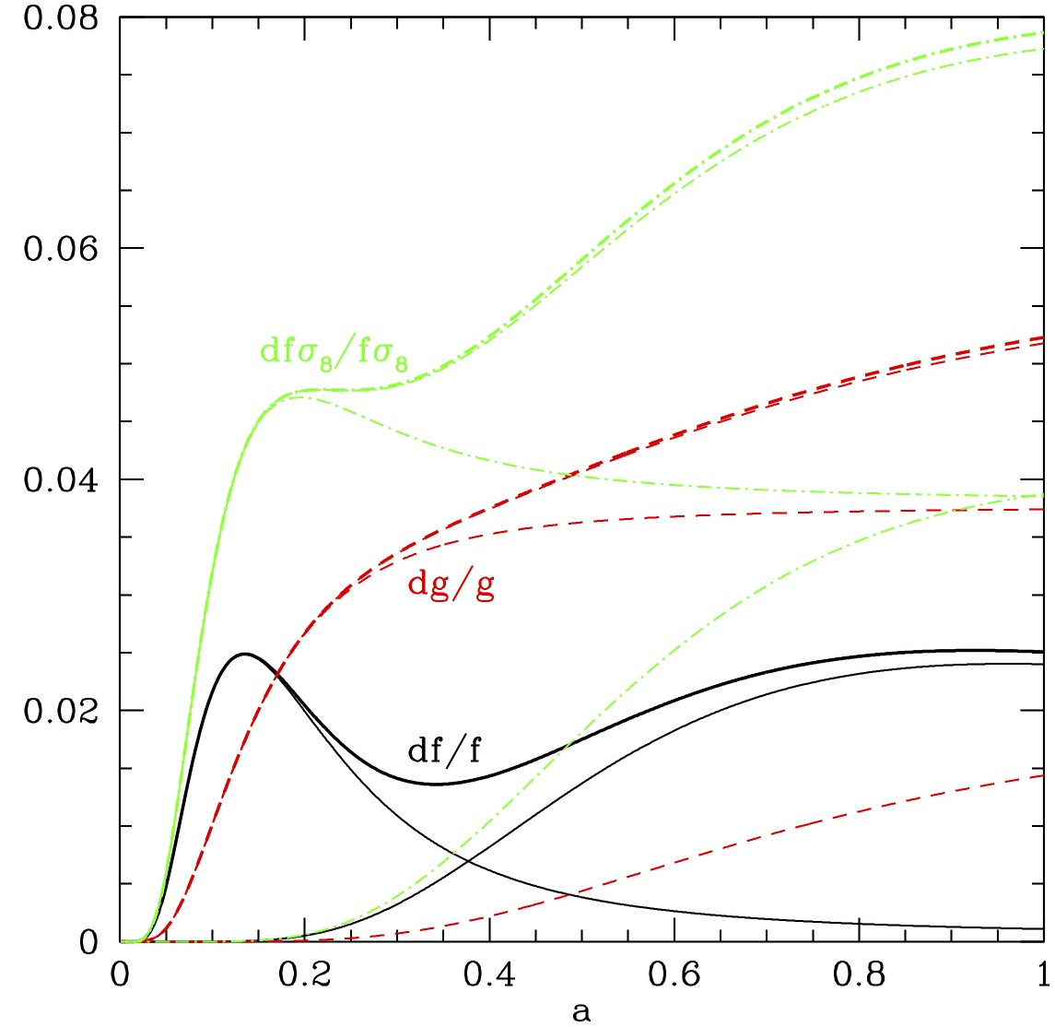
Early and Late Gravity
Thus gravity in the entire matter dominated era, z~3-1000, can be dealt with by one parameter.
We also showed that one can simply add this early era to late time modifications.
1 parameter for early times.
Next: late times.

Slide 17
Late Gravity
The simplest model independent parametrization for late time gravity is simply bins in a.
How many bins do we need for subpercent accuracy on the observable, fσ₈? (not on G_{m})
Accuracy determined by next generation data, e.g. DESI.
Want accurate parametrization for many different gravity theories.
Want informative constraints, i.e. pointing to physics.

Slide 18
Late Gravity
Want accurate parametrization for many different gravity theories.
We consider a suite of model behaviors for dG_{m}(a):
Rising (power law)
Falling (power law)
Nonmonotonic (Gaussian pulse)
DGP
f(R)
Nonmonotonic (convolution of Gaussians)
We solve for the exact growth, and want the residuals to fall within DESI/LSST precision.

Slide 19
Fitting Results
Comparison to using simple 2 bin values of G_{m}
bins: a=[0.25,0.5], [0.5,1]

Slide 20
Fitting Results
Comparison to using simple 2 bin values of G_{m}

Slide 21
Fitting Results
More important than the deviation is the impact on cosmology estimation – e.g. a sawtooth doesn’t look like a change in cosmology.
We calculate the bias on cosmology (Ω_{m},w₀,w_{a}) from using 2 bins to parametrize G_{m}(a):
Negligible!
Much much less than 1σ (dχ²=2.3).
Only 2-3 parameters needed.

Slide 22
Observation → Theory
Want informative constraints, i.e. pointing to physics.

Slide 23
Accurate Parametrization
Denissenya & Linder 2017a showed that gravity in the entire matter dominated era, z~3-1000, can be dealt with by one parameter: the area under dG_{m}, not G_{m}(a). This one parameter model is accurate to ~0.3% in the observables g, fσ₈.
Denissenya & Linder 2017b showed that gravity beyond the matter dominated era, z<3, can be dealt with by ~2 parameters, accurate to ~0.5%.
The simplest model independent parametrization for late time gravity is simply bins in a.
→ We need 2-3 bins for subpercent accuracy on the observable, fσ₈. (not on G_{m})
Denissenya & Linder 1703.00917
Denissenya & Linder 1709.08709

Slide 24
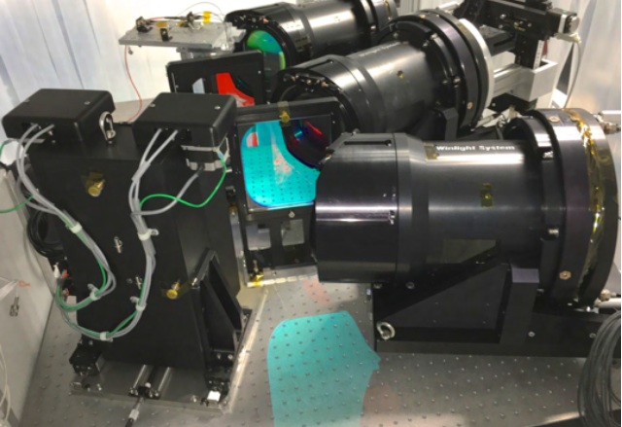
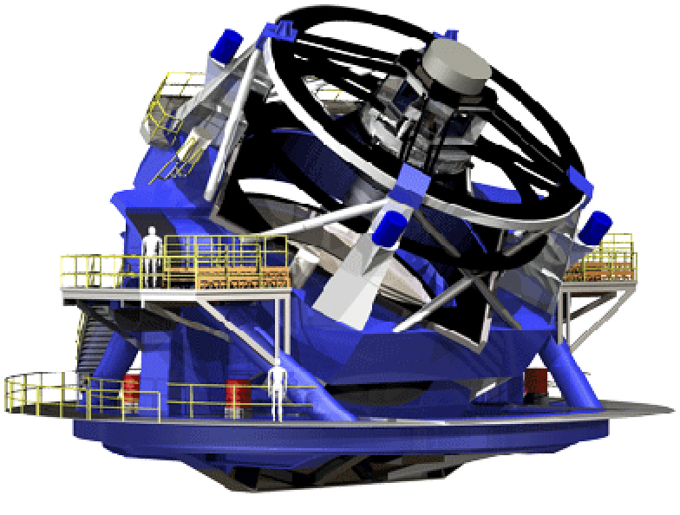
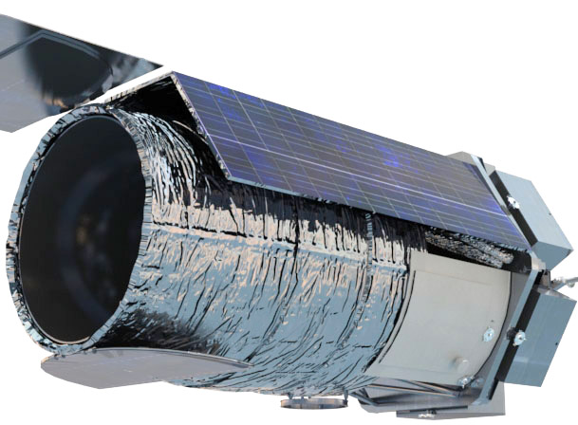
Future Surveys of Cosmic Structure
DESI will cover 14000 deg² with spectroscopy, measuring 3D clustering and BAO and RSD.
LSST will cover 18000 deg² with 6 band imaging, measuring weak lensing and photometric galaxy clustering.
WFIRST will go deep, with red/NIR imaging and IFU spectroscopy, measuring 3D clustering at z>1.5.

Slide 25
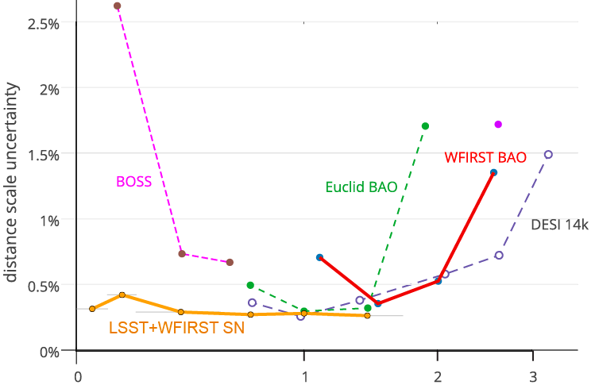
Mapping Cosmic Expansion
We will have sub% distance measurements over most of the cosmic expansion history.
Perlmutter+
z

Slide 26
The Pull of Gravity
In general relativity, (linear) growth of structure and expansion are tied together – one predicts the other. Cosmic growth tests GR.
Is growth suppressed?
Or is beyond linear modeling insufficient?
Growth rate dD/dlna =
Gil-Marín+ 1509.06386

Slide 27
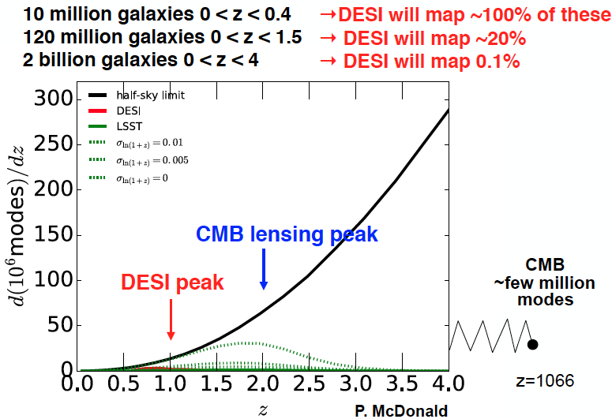
Mapping All Matter Perturbations

Slide 28
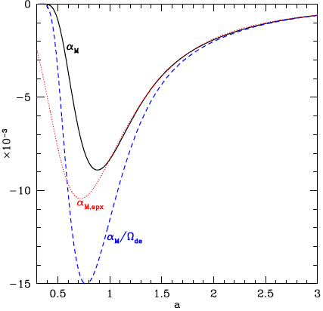
Testing Gravity
Very difficult to fit EFT/α modified gravity functions of time to observations with just a few parameters, even for simple theories.
Planck mass running
1 parameter f(R) gravity
But G_{matter}(a) can be fit with 2-3 parameters for growth observables.
Today
Cosmic scale factor →
Linder 1607.03113
To reveal gravity, must also look at:
Nonlinear regime and screening mechanisms
Tensor sector (gravitational waves)
Strong gravity systems (black holes)
Notes:
Even next generation cosmic survey data will only be able to fit a few parameters, not entire free functions.
The free functions are complicated (not described by 1 or 2 parameters) even for simple theories.
Cosmic surveys must partner with astrophysical studies of strong gravity and gravitational waves.

Slide 29
Summary & Future
We should test gravity because of the challenge: theory (uniqueness), experimental (extrapolation), observational (acceleration). [Not because we’re in love with any one theory, except maybe GR.]
DESI, Euclid, LSST, WFIRST, etc. will have exciting next generation surveys providing accurate tests of gravity.
Very difficult to go from theory → observations in model independent way: H(z) + 4 functions.
Keeping observations in front, we show subpercent accuracy with just 2-3 gravity parameters, for cosmic growth.
Future: does it work for lensing?

