Slide 1
Modified Gravity
2. How
Eric Linder
UC Berkeley
Essential Cosmology for the Next Generation 7 12 December 2017

Slide 2
This Course
Why and What?
Ways to modify gravity and ways not to. The many failures and why. What makes a consistent physical theory.
2. How?
Ways to model independently modify gravity.
3. Where?
Where are we now? Where do we go next?

Slide 3
General Approaches to Modify Gravity
How to approach modified gravity without choosing one particular theory:
Effective field theory
Property functions
Modified Poisson equations

Slide 4
Effective Field Theory
Allow every possible operator in the action, consistent with chosen symmetries (e.g. Robertson-Walker background, 2nd order equations of motion).
Quadratic action (for first order perturbations) has 7 terms, each with time dependent coefficient.
Used in many fields, e.g. particle physics, dark matter, etc. [See Cliff Burgess, COTB 2012]. However cosmology works in a time dependent background, so coefficients are functions not numbers.
Only valid for linear theory, unless one goes to higher order, with more terms and coefficients.
Gubitosi, Piazza, Vernizzi 1210.0201 Bloomfield, Flanagan, Park, Watson 1211.7054 Gleyzes, Langlois, Piazza, Vernizzi 1304.4840
Bellini & Sawicki 1404.3713 Linder, Sengör, Watson 1512.06180

Slide 5
Effective Field Theory
R – Ricci scalar; note conformal factor Ω(t)
K – extrinsic curvature
Λ – like scalar potential or cosmological constant
c – like scalar kinetic energy
Fully modified gravity (changing the tensor propagator) comes from traceless part of dK, so

Slide 6
Horndeski and Beyond
Horndeski gravity was not originally derived from EFT, but it is a special case with
4 coefficients rather than 7.
Note that if the tensor propagator is not changed, then = 0 and Horndeski is greatly reduced.
Horndeski has explicitly 2nd order EOM, but EFT guarantees stability even if appears higher order.
This leads to “Beyond Horndeski” gravity and DHOST (degenerate higher order scalar-tensor) theory.
Horndeski does give clues to nonperturbative formulation.

Slide 7
Property Functions
Combinations of EFT terms enter into observational effects.
In particular some affect only the scalar sector, some only the tensor sector, and some link the two.
Property function approach [Bellini & Sawicki 2014] clarifies these physical properties by organizing terms in 4 time dependent functions (in Horndeski case).
α_{M} – running Planck mass (coupling)
α_{K} – kineticity: scalar kinetic structure
α_{B} – braiding: mixing scalar and tensor sectors
α_{T} – tensor wave speed deviation (c_{T}²-1)
All are functions of time, and 0 within GR.

Slide 8

EFT Property Functions
Translation table between EFT and property function
α(EFT)
Linder, Sengör, Watson 1512.06180
EFT(α)

Slide 9
Property Functions
Action in terms of property functions:
T. Baker
α_{M} ~ d ln M² / Hdt
Beyond Horndeski involves α_{H}, related to
DHOST involves α_{L}, related to

Slide 10

Mapping to Gravity Models
Linder, Sengör, Watson 1512.06180
Bellini & Sawicki 1404.3713

Slide 11

Horndeski Gravity
Translation between α_{n} and Horndeski G_{i}(Φ,X).

Slide 12
Galileon Gravity

Slide 13
Property Functions α(t)
To proceed further, one must specify time dependence of α(t).
Regrettably common in the literature to see
but this is a very poor approximation!
It generically fails at z < 10 in all theory classes.
Beware! This appears as a default in HiCLASS code.
In EFT terms, this implies all action terms scale together, despite different powers of mass suppression and time dependences – it removes almost all EFT freedom.

Slide 14
Failure Illustrated
Planck mass running
1 parameter f(R) gravity
Today
Linder 1607.03113
Simplest model: f(R) only depends on one α. It looks nothing like
Notes:
Even next generation cosmic survey data will only be able to fit a few parameters, not entire free functions.
The free functions are complicated (not described by 1 or 2 parameters) even for simple theories.
Cosmic surveys must partner with astrophysical studies of strong gravity and gravitational waves.

Slide 15

“Tracker” Approximation
Another short cut used as an approximation all too often in the literature is called the tracker or attractor approximation.
This is only generically valid in the de Sitter limit, i.e. in the future!
It throws away all the natural dynamics, i.e. the Klein-Gordon equation for .
Proponents will claim that it is one possible evolution for and so a subclass of the full theory.
Such work is then neither model independent nor representative.

Slide 16
“Tracker” Approximation
But it gets worse!
This approximation implies
Since
the tracker condition forces
in contrast to the cosmological constant fine tuning
The fine tuning is at the 10⁻²⁴⁰ level vs Λ’s 10⁻¹²⁰. It’s not a tracker, it’s super fine tuned!

Slide 17

Functions of Time
Why is no simple time dependence expected?
Recall that the α are ratios of Lagrangian coefficients, e.g.,
Observables in turn are ratios of α’s, e.g. the gravitational slip (difference between gravity strengths):
Generally,
no simple time dependence!

Slide 18
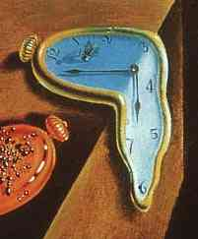
Gernerally Testing Gravity
Cosmic acceleration suggests that Einstein relativity may need modification.
How should we test cosmic gravity, other than one model at a time? How do we connect observations and theory in a model independent manner?
Note the expansion history H(z) is merely one free function of time.
For cosmic structure we have 5 times as many! (kineticity, Planck mass running, braiding, tensor speed).
Now the tensor sector is as important as the scalar (matter) sector!
Notes:
Cosmic acceleration is one of the greatest mysteries of modern physics.
Growth of cosmic structure in modified gravity involves at least 5 functions: the usual Hubble expansion rate plus at least 4 others.
The tensor sector enters into braiding and tensor propagation speed.

Slide 19
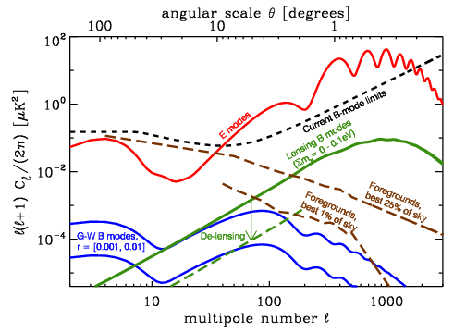
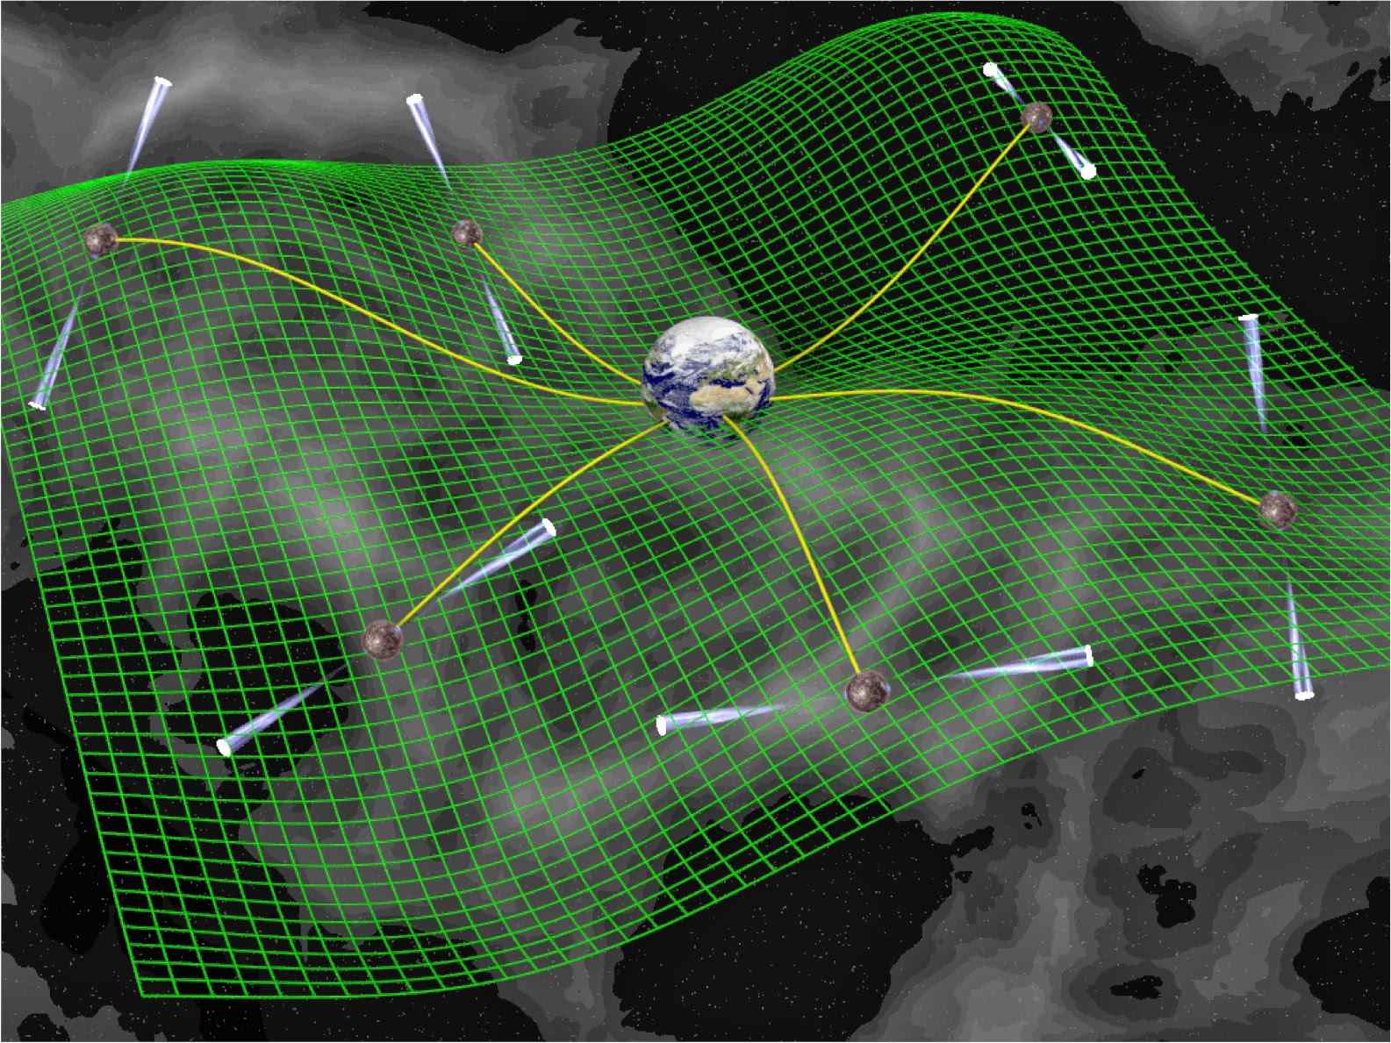
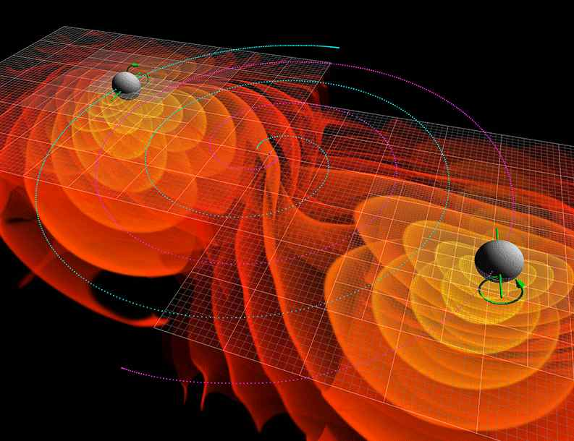
Understanding Gravity
Unexpected synergies!
The tensor sector is accessible through gravitational waves: CMB B-modes, pulsar timing arrays, interferometers.
Galaxy surveys have deep complementarity with CMB surveys (and PTA, LIGO/LISA).
Notes:
Even next generation cosmic survey data will only be able to fit a few parameters, not entire free functions.
The free functions are complicated (not described by 1 or 2 parameters) even for simple theories.
Cosmic surveys must partner with astrophysical studies of strong gravity and gravitational waves.

Slide 20
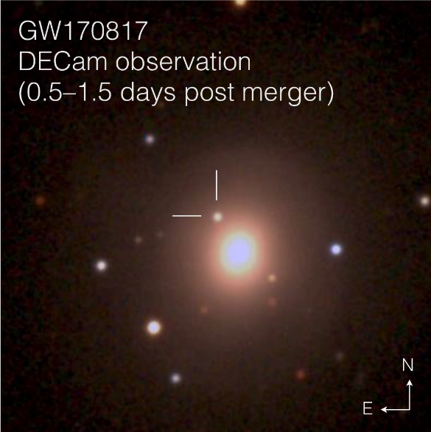
Gravitational Waves
Tensor constraints came sooner than expected!
GW170817 + GRB1070817A: synchronicity of GW and photon arrival within 2 seconds after signal propagation for 130 My (400 x 10¹³ s – thanks to Dark Energy Camera blind search) limits
c_{T} /c – 1 < 10⁻¹⁵
ruling out almost all theories of fully modified gravity!
See Thursday talk by Prof. Soares-Santos

Slide 21
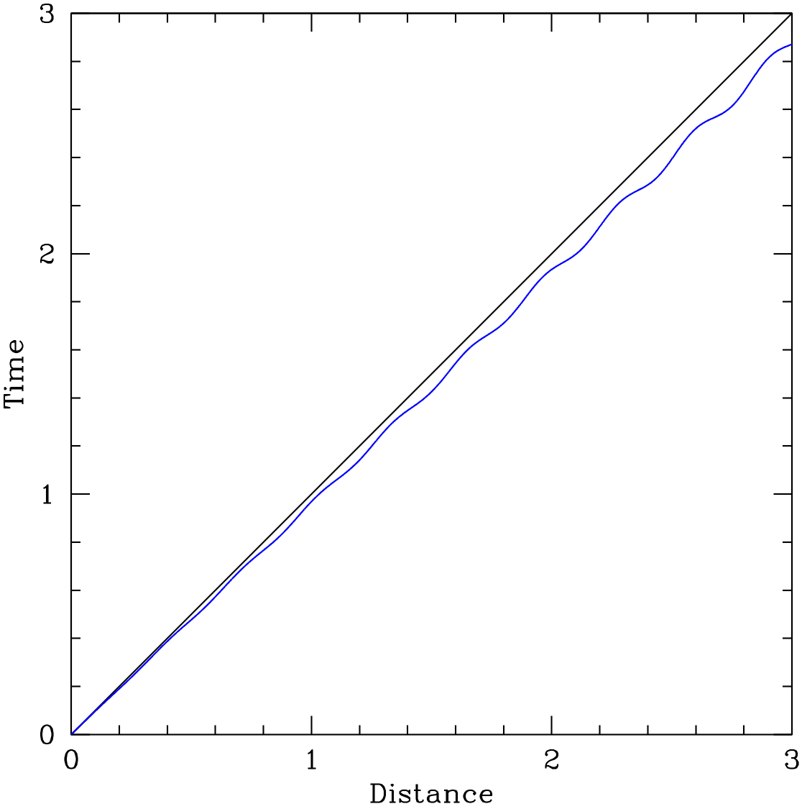
Implications of c_{T} = c
Any theory with c_{T} ≠ c is essentially ruled out. In particular, this was the definition of “fully modified” gravity from Lecture 1!
Δt
Light follows null geodesics.
If GW follows disformal → Δt.
Light v=c
GW v=c_{GW}
Only conformal theories survive.

Slide 22
Implications of c_{T} = c
All disformal theories are gone, leaving only conformal theories (no more shift symmetry!).
f(ϕ)R + scalar terms
Horndeski with G₅,G₄(X) (including Galileons) ruled out, much of Beyond Horndeski, all self tuning theories.
Personal view: conformal theories are unstable to quantum corrections and arbitrary in form. They are continuous with ΛCDM, not fully distinct. Some form of self tuning was our best hope to solve Λ problem.
GR is looking more and more beautiful!

Slide 23
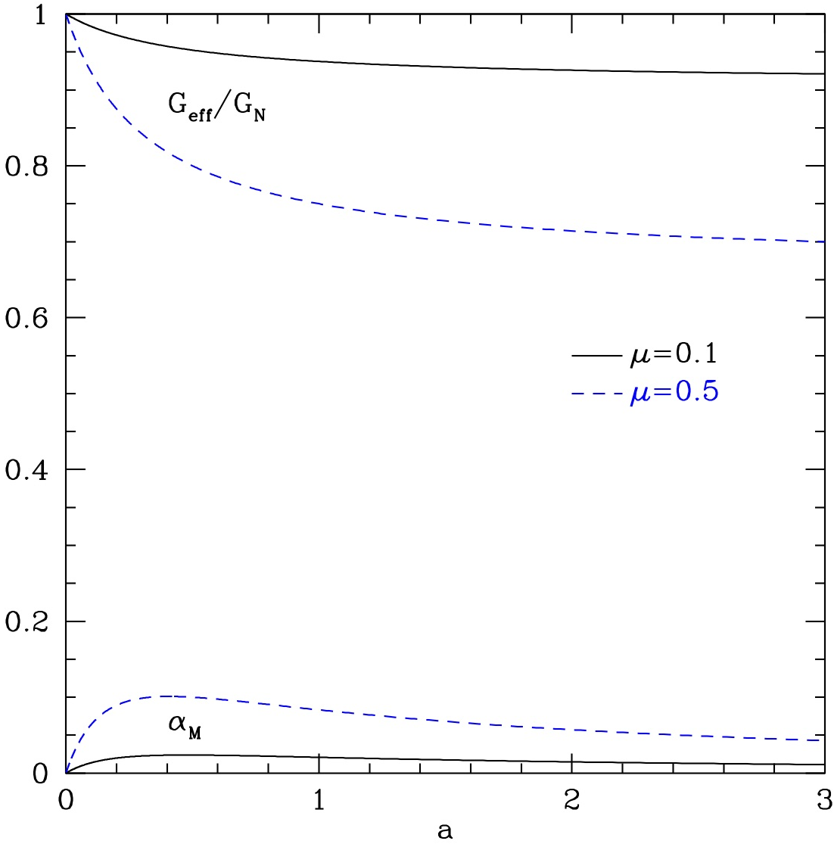
Some implications of c_{T}=c
α_{T}=0 doesn’t directly affect ghost condition but does simplify stability and observables (effective gravitational strength).
In particular, the condition for light and matter to feel the same gravitational strength becomes
α_{B} = -2α_{M}
New class: “No Slip gravity”
Weaker gravity helps with fit to growth data.
Linder 2017

Slide 24
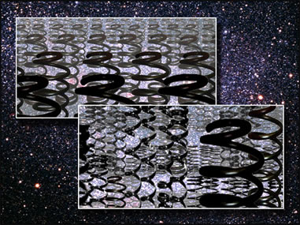
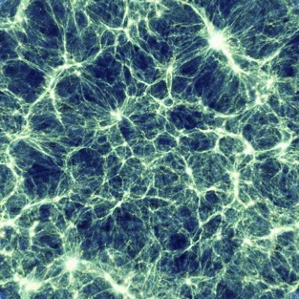
The Richness of Gravity
In GR, expansion determines growth.
In modified gravity, cosmology is much richer. Plus the tensor sector!
We have learned to fit H(z) with just a few parameters: Ω_{m}, w₀, w_{a}.
Can we do the same with gravity functions?
Need close connection between theory, computation, and data to test/interpret the results.

Slide 25
Connecting Theory to Observation
Practical use of EFT/property functions, i.e. fitting time dependence, has not succeeded so far – and doesn’t look promising.
1 parameter f(R) gravity
Today
How should we connect theory to observations to learn about modified gravity?
Where do we go next? – Lecture 3
(and see lectures by Prof. Mota on simulations for a specific model)

